Slide 1

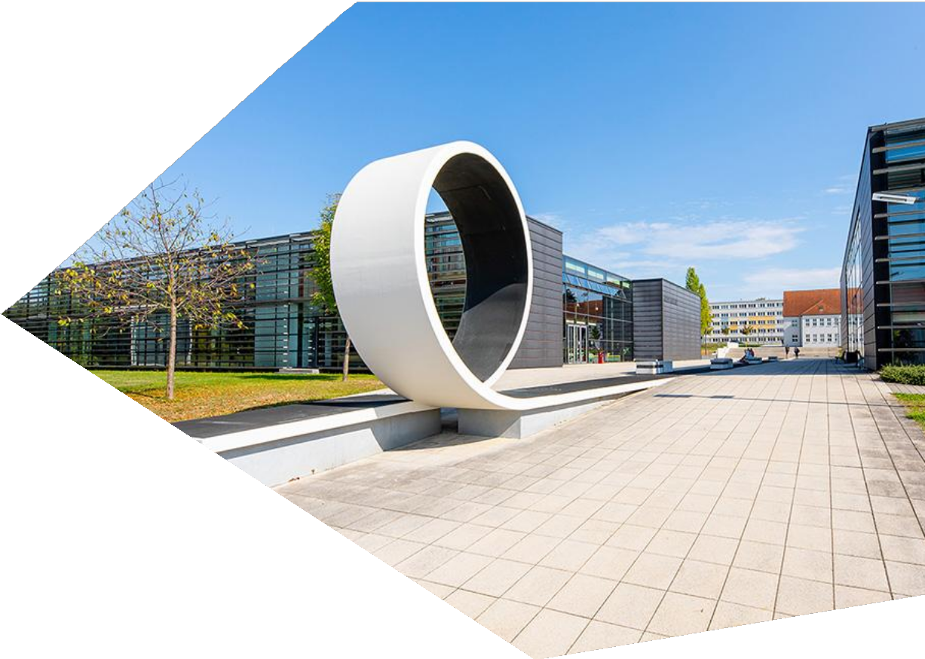
Project : Rockyborg
Presented by: Team 2
(progress on enabling autonomous line-following using Rockyborg. This update covers hardware, software, challenges, and next steps.)
WHZ/Helge Gerischer

Slide 2
Autonomous Driving Robot in a parkour
Project Overview
Rockyborg
Objective: Enable autonomous movement of the Rockyborg by following a line.
Team Members: Sreehari, Vignesh, Abhilash, Sidharth, Abin, Pawan,Shubha, Neezar, Amir, Dhruvi.
Project Manager : Dhruvi Moradiya. Scrum Master : Shubha Mahesh
Team | Leader | Members
Hardware | Neezar | Neezar,Ameer
Software | Sreehari | Sreehari,Vignesh,Abhilash,Sidharth,Abin,Pawan
Testing & Quality | Vruksha | Vruksha,Ameer
Documentation | Shubha | Shubha, Dhruvi

Slide 3
Autonomous Driving Robot in a parkour
🎯Milestone Goal
Robot should follow the straight line
✅ Key Deliverables by Team Responsibility
No. | Deliverable | Description
1 | Hardware Integration | Assembled Rockyborg with Pi, motors, and camera; verified connections and setup.
2 | Software Environment Setup | Installed Raspberry Pi OS, OpenCV, and GPIO; enabled camera and SSH.
3 | Image Processing & Camera Testing | Enabled PiCamera and webcam; captured live feed; implemented basic line detection.
4 | Motor Control & Navigation Logic | Developed straight-line movement logic; resolved wiring errors; GUI verified.
5 | Sprint Planning & Task Management | Defined roles, sprint timelines, and tasks; conducted meetings; used GitHub.
6 | Testing & Validation | Conducted unit and integration tests for camera, motor, and detection modules.
7 | Issue Resolution | Diagnosed PiCamera issue; used webcam as workaround; adjusted code accordingly.
8 | Final Output (To Date) | Robot moves in straight line using webcam; line detection and motors functional.

Slide 4
Autonomous Driving Robot in a parkour
Sprints
🌀 Sprint 1: Research & Planning
📅 Duration: Mar 18 – Mar 26 🎯 Goal: Establish project scope and prepare development environment
🌀 Sprint 3: Development & Integration
📅 Duration: Apr 18 – May 7
🎯 Goal: Develop line-following logic and integrate modules
Deliverables
Implemented live video capture and basic image processing
Developed and tested straight-line movement logic
Debugged motor direction issues and resolved wiring errors
Verified movement using GUI testing and webcam
Deliverables
Identified hardware components (Pi, camera, motors, chassis)
Researched software libraries (OpenCV, GPIO)
Defined team roles and sprint plan
Verified Raspberry Pi boot, connectivity, and power setup
🌀 Sprint 2: Setup & Basic Testing
📅 Duration: Mar 26 – Apr 17 🎯 Goal: Assemble hardware and complete initial system configuration
Deliverables
Assembled Rockyborg hardware and completed wiring
Installed Raspberry Pi OS and enabled SSH, Wi-Fi
Installed OpenCV and GPIO libraries
Verified camera interface and basic motor functions via Python
🌀 Sprint 4: Optimization & Validation
📅 Duration: May 8 – May 18
🎯 Goal: Finalize functionality and prepare for full testing
Deliverables
Validated line detection and motor coordination using webcam
PiCamera hardware issue identified and alternative solution implemented
Optimized code for consistent straight-line motion
Planned enhancements for speed, curve handling, and performance benchmarking

Slide 5
Autonomous Driving Robot in a parkour
🌀 Sprint 5: Implementation & Optimization
📅 May 18 – May 31, 2025
🎯 Goal:
Improve line-following with real-time curve tracking, optimize motor speed, and resolve PiCamera issues.
🔧 Tasks:
Enhance Line Detection: Add curve tracking to improve path accuracy
Motor Tuning: Adjust speed for better turns and stability
PiCamera Fix: Investigate and attempt permanent solution
Testing & Benchmarking: Run extended tests, evaluate speed and performance

Slide 6
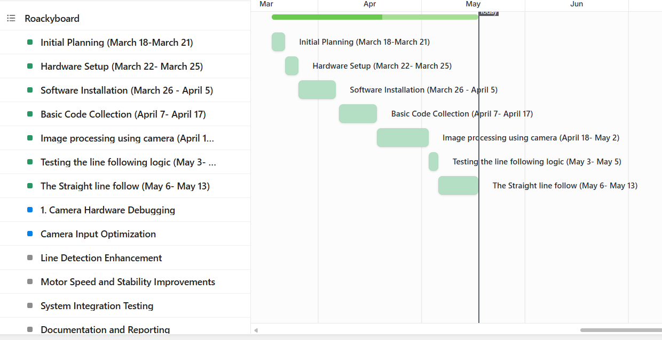
Autonomous Driving Robot in a parkour
📄 Gantt Chart – Rockyborg Project
(March 18 – May 18)

Slide 7
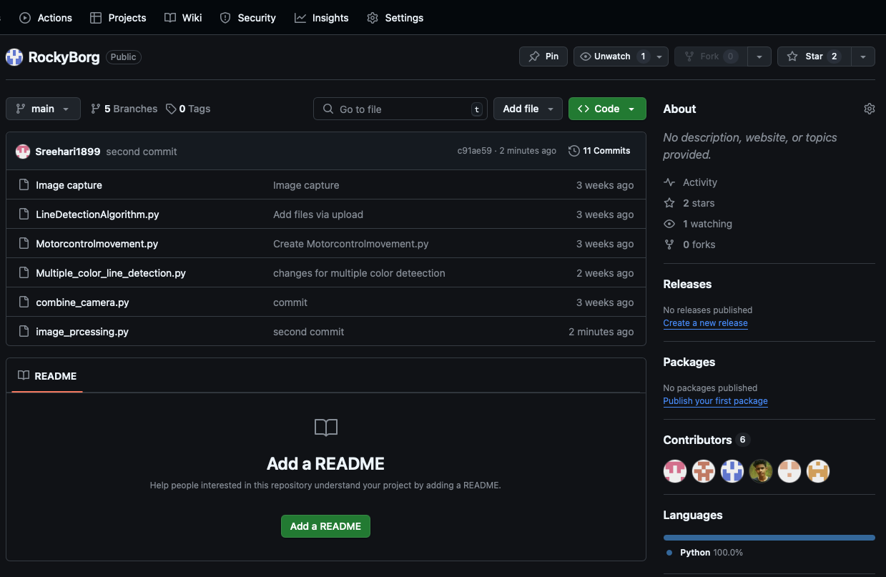
Autonomous Driving Robot in a parkour
🗓️ Meetings and Discussions So Far
Collaboration & Meetings
Kickoff Meeting: Defined team roles and clarified project objectives
Tech Sync: Completed Raspberry Pi and camera setup
GitHub Review: Structured repository, committed initial scripts
Debugging Session: Resolved SSH and camera detection issues
Task Review: Reviewed sprint progress and initiated line-following logic development
Milestone meeting: Review the process and check the algorithms and code for the line following

Slide 8
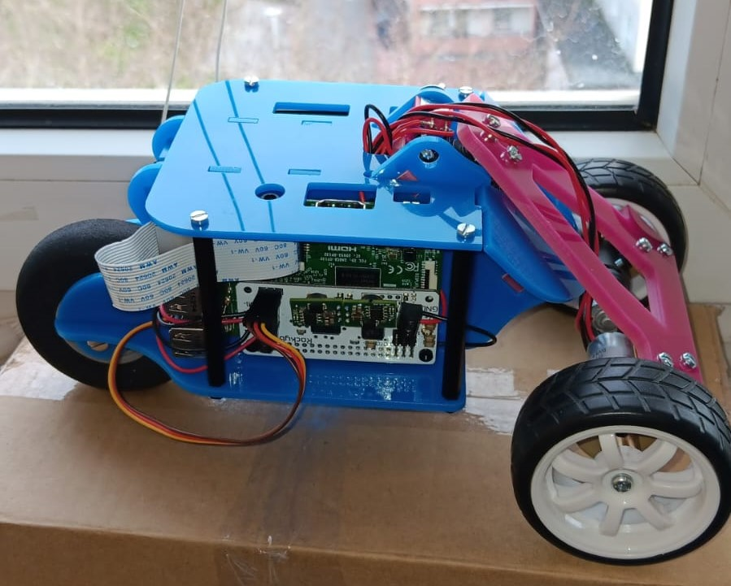
Autonomous Driving Robot in a parkour
🛠️ Hardware Team
Hardware Progress
Step 1: Inventory check – All components accounted for
Step 2: Assembled chassis and mounted electronics
Step 3: Conducted physical verification of wiring and component operation
Status: Robot is fully assembled and functional

Slide 9
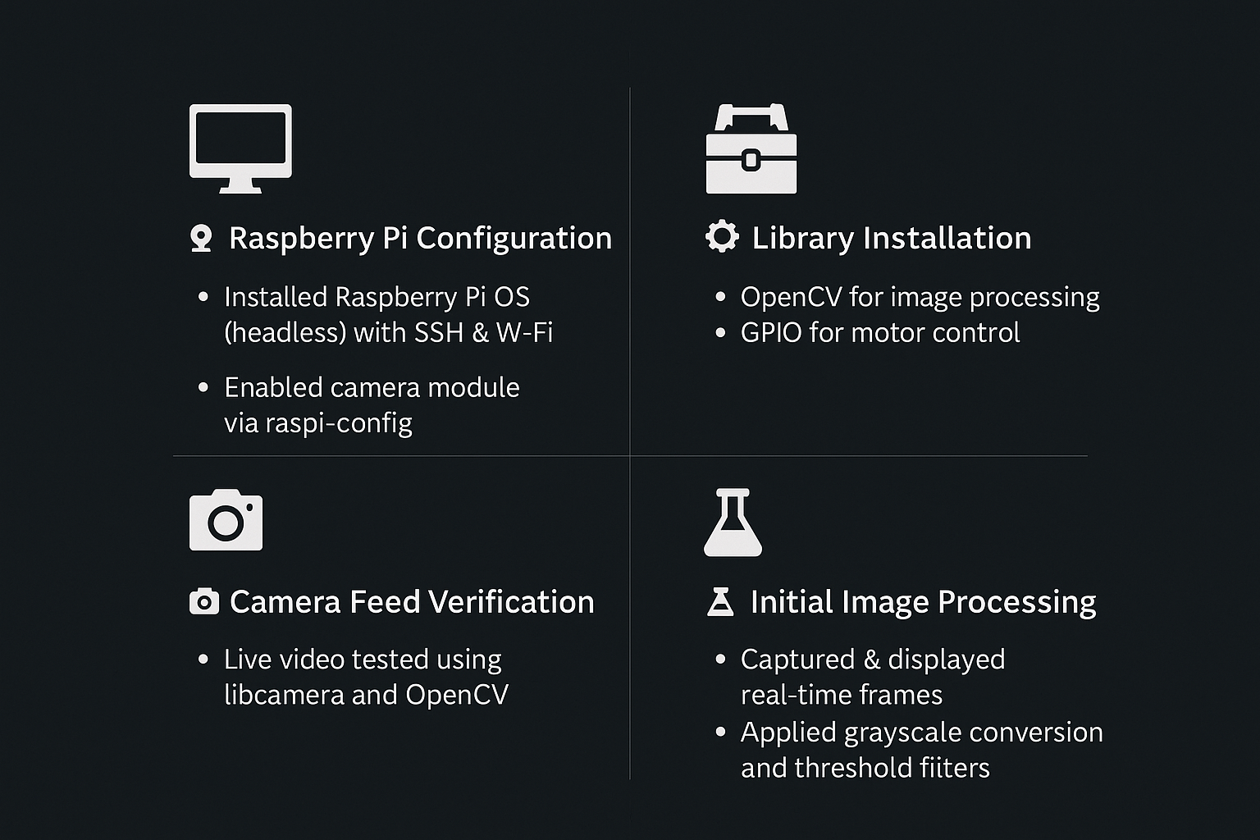
Autonomous Driving Robot in a parkour
🎯 Software Progress – System Setup & Image Processing
🖥️ Raspberry Pi Configuration
Installed Raspberry Pi OS (headless) with SSH & Wi-Fi
Enabled camera module via raspi-config
🧰 Library Installation
🧠 OpenCV for image processing
⚙️ GPIO for motor control
📷 Camera Feed Verification
Live video tested using libcamera and OpenCV
Frame display using cv2.VideoCapture()
🧪 Initial Image Processing
Captured & displayed real-time frames
Applied grayscale conversion and threshold filters

Slide 10
Autonomous Driving Robot in a parkour
🆕 Rockyborg Software Team
Progress Update – As of May 17, 2025
🔁 Alternative Used:
🖱️ Switched to USB webcam
✅ Successfully tested with OpenCV
🧠 Processing Success:
Stable feed from webcam
Line detection functioning in real-time conditions

Slide 11
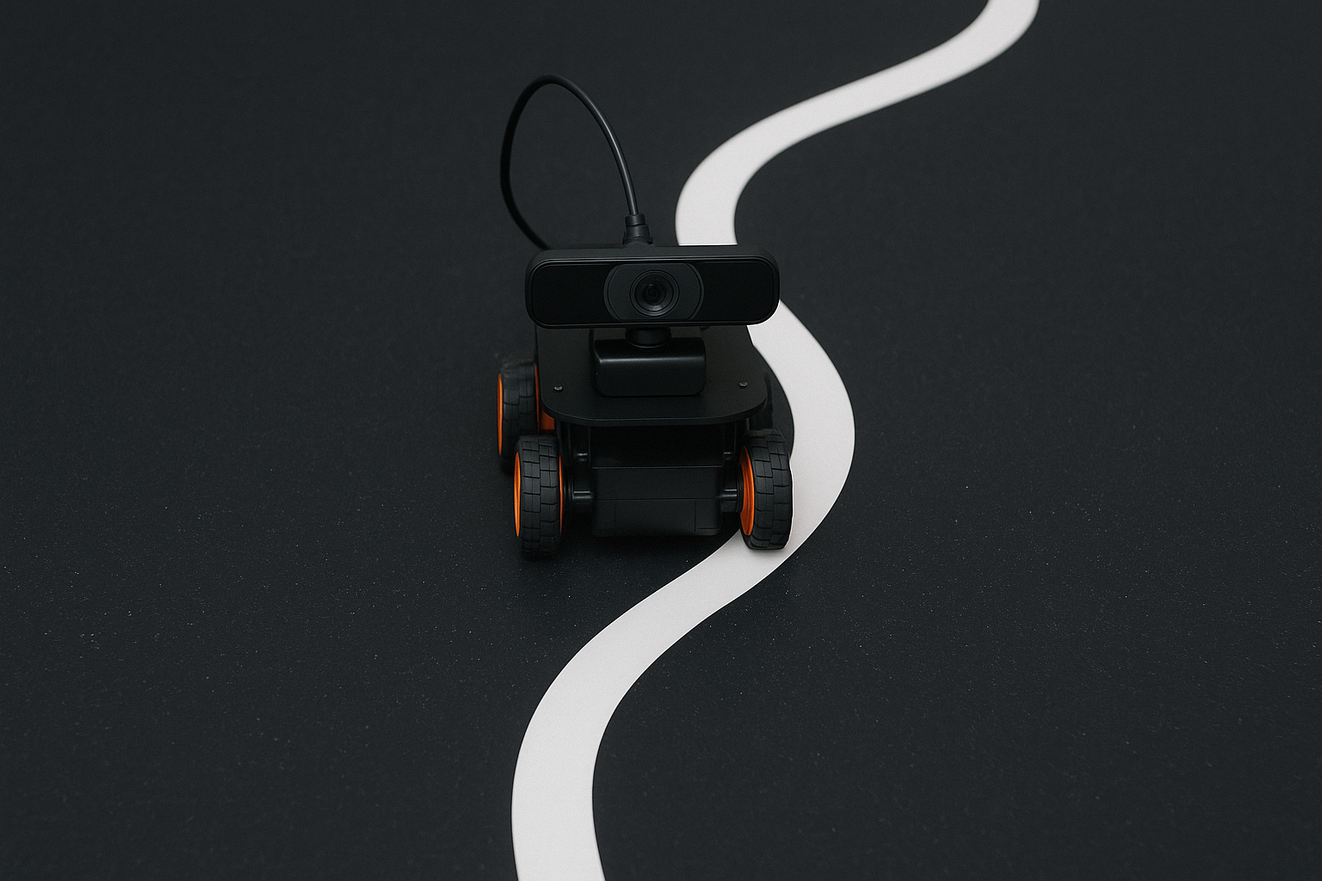
Autonomous Driving Robot in a parkour
💻 Rockyborg Software Team Current Status.
⚙️ : Initial Testing Results – Line Following Validation
📷 Webcam Feed
Accurate line detection on live video stream
Used binary masks for path extraction
⚠️ Motor Issue Found
🔁 Motors reversed due to incorrect GPIO wiring
🧰 Fixed hardware & updated Python control logic
✅ Post-Fix Results
GUI confirmed correct motor directions
Robot successfully follows a straight line

Slide 12
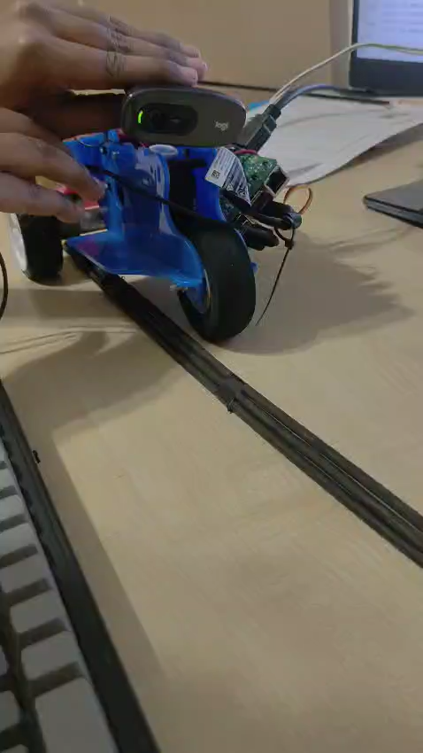
Autonomous Driving Robot in a parkour
✅: Final Outcomes – Achievements & Challenges
📸 Camera:
PiCamera works elsewhere but not on our unit
USB webcam used as a reliable substitute
🧠 Algorithm:
Line detection logic accurate & responsive
Real-time processing achieved
🚗 Motor Control:
Debugged direction logic
Achieved correct, aligned movement
⚠️ Pending Improvements:
🚀 Speed calibration for smoother performance
🌀 Add support for curves and turns
🔧 Investigate PiCamera pin repair or replacement
(Outcome)

Slide 13
Autonomous Driving Robot in a parkour
🔜 : Next Steps
Upcoming Implementation Goals (Software):
Enhance line detection with real-time curve tracking
Fine-tune motor speed for better stability and accuracy
Explore permanent fix for PiCamera hardware issue
Conduct extended testing and performance benchmarking
🧪 Testing Team – Responsibilities & Process
🎯 Objective
Ensure each module (camera, line detection, motor control, and integration) functions as expected under real-world conditions.
Category | Task Description | Status
Hardware Verification | Confirm proper connection of hardware components | Completed
Hardware Verification | Test power supply and motor controller wiring | Completed
Camera Module Testing | Validate live video feed from the camera | Completed
Line Detection Testing | Test detection on various line types (straight, curves, junctions) | Upcoming
Line Detection Testing | Come up with diverse test scenarios | Upcoming

